Slide 1
Lecture 5c Algorithm Analysis 3

Slide 2
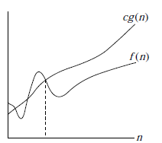

Recall: Other Asymptotic Notations
t(n) = O(g(n)) ↔
∃c∈R^{≥0}, n₀∈N, ∀n≥n₀: t(n) ≤ cg(n)
t(n)
n_{o}

Slide 3
Other Asymptotic Notations
t(n)=Ω(g(n)) ↔ ∃c∈R^{>0},∃n₀∈N,∀n≥n₀: t_{n}≥cg(n)
n_{o}

Slide 4
Other Asymptotic Notations
f(n)=Θ(g(n)) ↔ f(n)=O(g(n)) & f(n)=Ω(g(n)) ≈
t(n)=Θ(g(n)) ↔ ∃c₁,c₂∈R^{>0},∃n₀∈N,∀n≥n₀:
c₁g(n)≤f_{n}≤c₂g(n)

Slide 5
Other Asymptotic Notations
f(n)=o(g(n)) ↔ ∀c∈R^{>0},∃n₀∈N,∀n≥n₀: f_{n}<cg(n)
f(n)=ω(g(n)) ↔ ∀c∈R^{>0},∃n₀∈N,∀n≥n₀: f_{n}>cg(n)
Equivalently
f(n)=o(g(n)) ↔ f(n)=O(g(n)) & f(n)≠Ω(g(n))
f(n)=o(g(n)) ↔ f(n)=O(g(n)) & f(n)≠Θ(g(n))
f(n)=ω(g(n)) ↔ f(n)=Ω(g(n)) & f(n)≠O(g(n))
f(n)=ω(g(n)) ↔ f(n)=Ω(g(n)) & f(n)≠Θ(g(n))

Slide 6
Other Asymptotic Notations
Analogy with numbers

Slide 7
Summary
Rules for constants, sums, products
Maximum rule

Slide 8
Rule for Constants
d(n)=Θ(f(n)) → ad(n)= Θ(f(n)) for any positive constant a
Same for O
Constants are not important when determining order of functions

Slide 9
Recall: Russian multiplication
Worst case
┌log₂x┐ [divisions by 2, multiplications by 2,
additions]
x < 10^{m}
log₂x < log₂(10^{m}) = m*log₂10

Slide 10
Recall: Russian multiplication
Number of operations is
c_{m} < ┌ m*log₂10 ┐
log₂10 is a constant
∴ c_{m} = O(m)
t_{m} = c_{m}*Δ
∴ t_{m}= O(m)

Slide 11
Corollary 1
11
log(nª) = Θ(log(n))
log(nª) = a*log(n) = Θ(log(n))

Slide 12
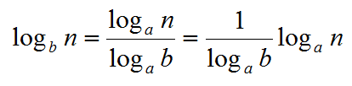
Corollary 2
constant
12
log_{b}(n) = Θ(log_{a}(n)) for any base a>1
= Θ(log_{a}(n))
In asymptotic notations, the base of algorithms is not important, we simply write Θ(log(n))

Slide 13
Rule for Sums
d(n)=Θ(f(n)) & e(n)=Θ(g(n)) →
d(n)+e(n) = Θ(f(n)+g(n))
Same for the other asymptotic notations
To find the order of a sum of functions, we take the sum of the orders

Slide 14
Rule for Sums
Example
t(n) = 5n³-77n+2log₂n²
t(n) = Θ(5n³-77n) + Θ(2log₂n²) =
= Θ(n³) + Θ(log₂n) =
= Θ(n³ + log₂n)
[will see later that actually t(n) = O(n³)]

Slide 15
Rule for Products
d(n)=Θ(f(n)) & e(n)=Θ(g(n)) →
d(n)*e(n) = Θ(f(n)*g(n))
Same for the other asymptotic notations
To find the order of a product of functions, we take the product of the orders

Slide 16
Maximum Rule
d(n)=O(f(n)) & e(n)=O(g(n)) →
d(n)+e(n) = O(max(f(n)+g(n)))
[max is taken for large enough values of n]
Valid for O only, not for Θ

Slide 17
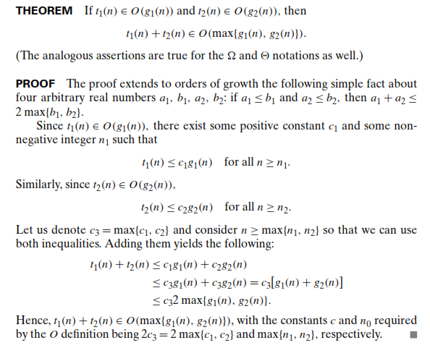
Proof of maximum rule

Slide 18
Maximum Rule
Continue Example
t(n) = 5n³-77n+2log₂n² =
= Θ(n³) + Θ(log₂n) =
= O(n³) + O(log₂n) = [for n≥2 n>log₂n]
= O(n³) + O(n) =
= O(n³)

Slide 19
Summary
Rules for constants, sums, products
Maximum rule
More on analysis in general will follow. But we jump now to Analysis of iterative programs.

